Slide 1
Econ 200 Module 4 Lecture 11

Slide 2
Outline
Marginal Costs
Graphing Cost Curves
Long Run Cost Curve
Efficiencies of Scale in Production
Reading: Ch 12.6-12.8

Slide 3
Jill’s Average Total Cost per Pizza
If we divide the total cost of the pizzas by the number of pizzas, we get the average total cost of the pizzas.
Quantity of Workers | Quantity of Pizza Ovens | Quantity of Pizzas per Week | Cost of Pizza Ovens (Fixed Cost) | Cost of Workers (Variable Cost) | Total Cost of Pizzas per Week | Cost per Pizza (Average Total Cost)
0 | 2 | 0 | $800 | $0 | $800 | —
1 | 2 | 200 | 800 | 650 | 1,450 | $7.25
2 | 2 | 450 | 800 | 1,300 | 2,100 | 4.67
3 | 2 | 550 | 800 | 1,950 | 2,750 | 5.00
4 | 2 | 600 | 800 | 2,600 | 3,400 | 5.67
5 | 2 | 625 | 800 | 3,250 | 4,050 | 6.48
6 | 2 | 640 | 800 | 3,900 | 4,700 | 7.34

Slide 4


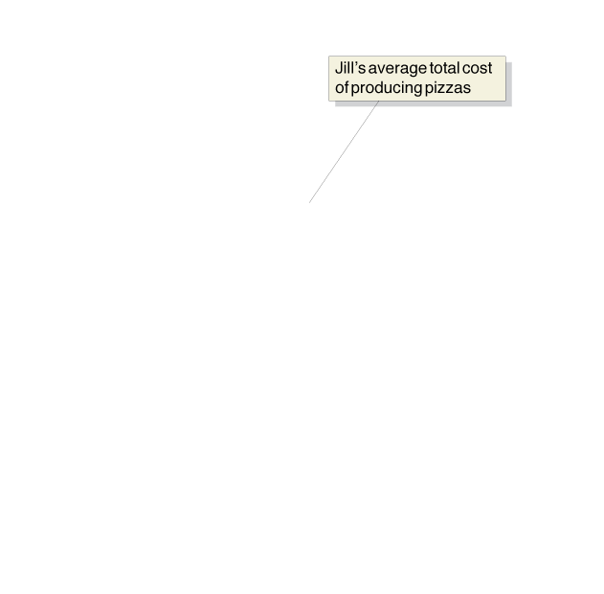
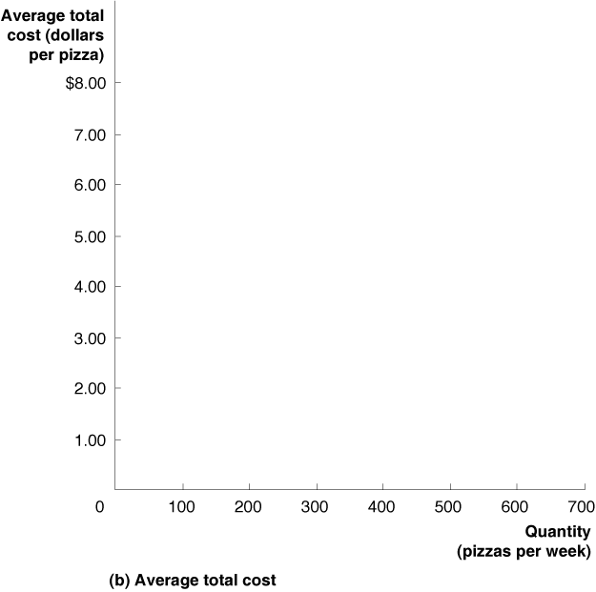
The Restaurant’s Average Total Cost Curve
The “falling-then-rising” nature of average total costs results in a U-shaped average total cost curve.

Slide 5
Decomposing the Total and Average Costs
TC / Q = FC / Q + VC / Q
The first quantity is average total cost.
The second is average fixed cost: fixed cost divided by the quantity of output produced.
The third is average variable cost: variable cost divided by the quantity of output produced.
So ATC = AFC + AVC

Slide 6
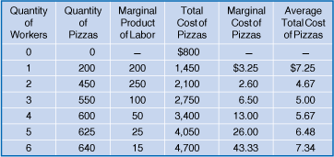
Marginal Costs of Production
We can also define the marginal cost as the change in a firm’s total cost from producing one more unit of a good or service; in symbols,

Slide 7
Marginal Costs of Production
The ΔQ is generally needed, because we don’t see quantity increasing by only one unit at a time.

Slide 8
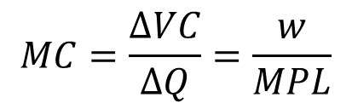
Marginal Costs of Production
Since the only part of TC that changes with output is the variable cost, then we see that:
$$MC=\frac{∆VC}{∆Q}=\frac{w}{MPL}$$

Slide 9

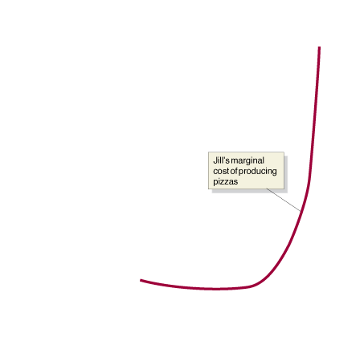
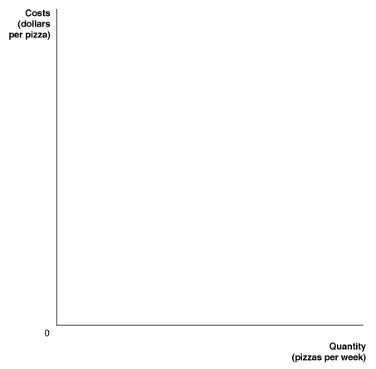
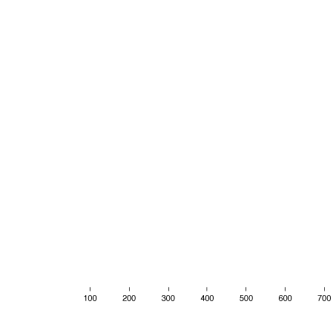



Graphing Average and Marginal Costs
Since the average cost of production “follows” the marginal cost down and then up, this generates a U-shaped average cost curve.
Notes:
We can use the information in the table to
calculate Jill’s marginal cost and average
total cost of producing pizzas. For the first
two workers hired, the marginal product of
labor is increasing, which causes the marginal
cost of production to fall. For the last
four workers hired, the marginal product
of labor is falling, which causes the marginal
cost of production to increase. Therefore,
the marginal cost curve falls and then
rises—that is, has a U shape—because the
marginal product of labor rises and then
falls. As long as marginal cost is below average
total cost, average total cost will be falling.
When marginal cost is above average
total cost, average total cost will be rising.
The relationship between marginal cost and
average total cost explains why the average
total cost curve also has a U shape.

Slide 10
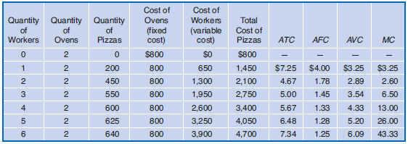
Observations about Costs
Observe that:
In each row, ATC = AFC + AVC.
When MC is above ATC, ATC is rising..
Notes:
Jill’s costs of making pizzas are shown in
the table and plotted in the graph. Notice
three important facts about the graph:
(1) The marginal cost (MC), average total
cost (ATC), and average variable cost (AVC)
curves are all U shaped, and the marginal
cost curve intersects both the average variable
cost curve and the average total cost
curve at their minimum points. (2) As output
increases, average fixed cost (AFC) gets
smaller and smaller. (3) As output increases,
the difference between average total cost
and average variable cost decreases. Make
sure you can explain why each of these
three facts is true. You should spend time
becoming familiar with this graph because
it is one of the most important graphs in
microeconomics.

Slide 11
Observations about Costs
Observe that:
When MC is above ATC, ATC is rising.
The same is true for MC and AVC.
Notes:
Jill’s costs of making pizzas are shown in
the table and plotted in the graph. Notice
three important facts about the graph:
(1) The marginal cost (MC), average total
cost (ATC), and average variable cost (AVC)
curves are all U shaped, and the marginal
cost curve intersects both the average variable
cost curve and the average total cost
curve at their minimum points. (2) As output
increases, average fixed cost (AFC) gets
smaller and smaller. (3) As output increases,
the difference between average total cost
and average variable cost decreases. Make
sure you can explain why each of these
three facts is true. You should spend time
becoming familiar with this graph because
it is one of the most important graphs in
microeconomics.

Slide 12

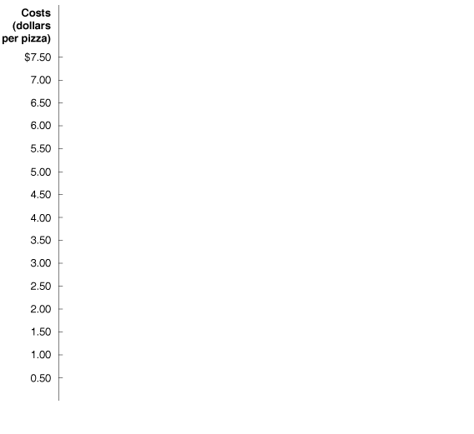
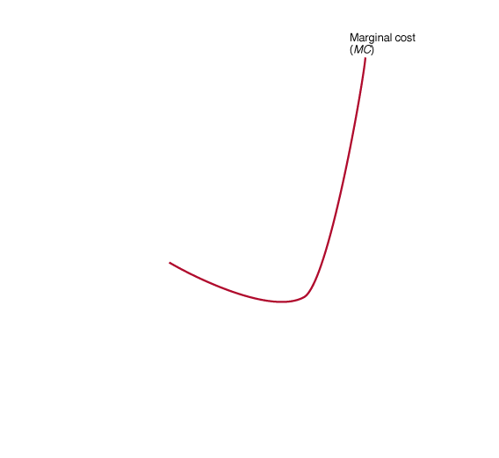
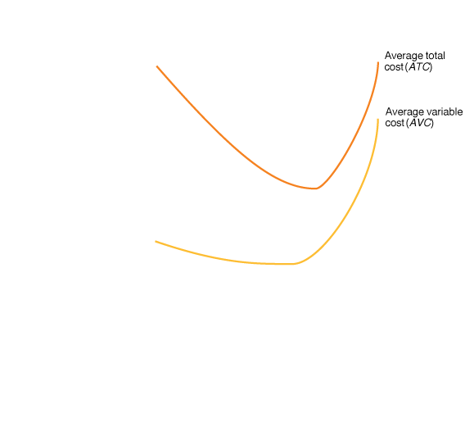
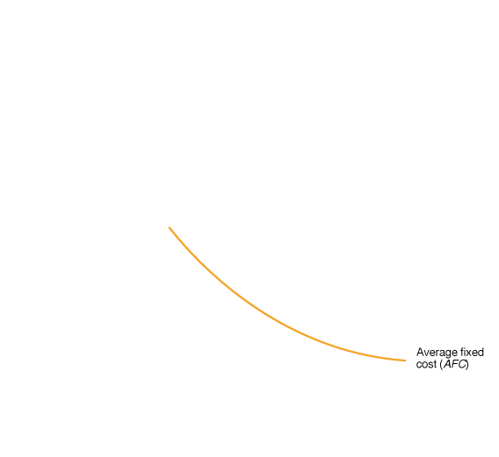


Graphing the Various Cost Curves
This results in both ATC and AVC having their U-shaped curves.
→The MC curve cuts through each at its minimum point.
→ATC is vertical sum of AVC and AFC curves.
→The ATC and AVC curves converge.

Slide 13
The Long Run and Average Costs
Recall that the long run is a sufficiently long period of time that all costs are variable.
So In the long run, there is no distinction between fixed and variable costs.
A long-run average cost curve shows the lowest cost at which a firm is able to produce a given quantity of output in the long run, when no inputs are fixed.

Slide 14
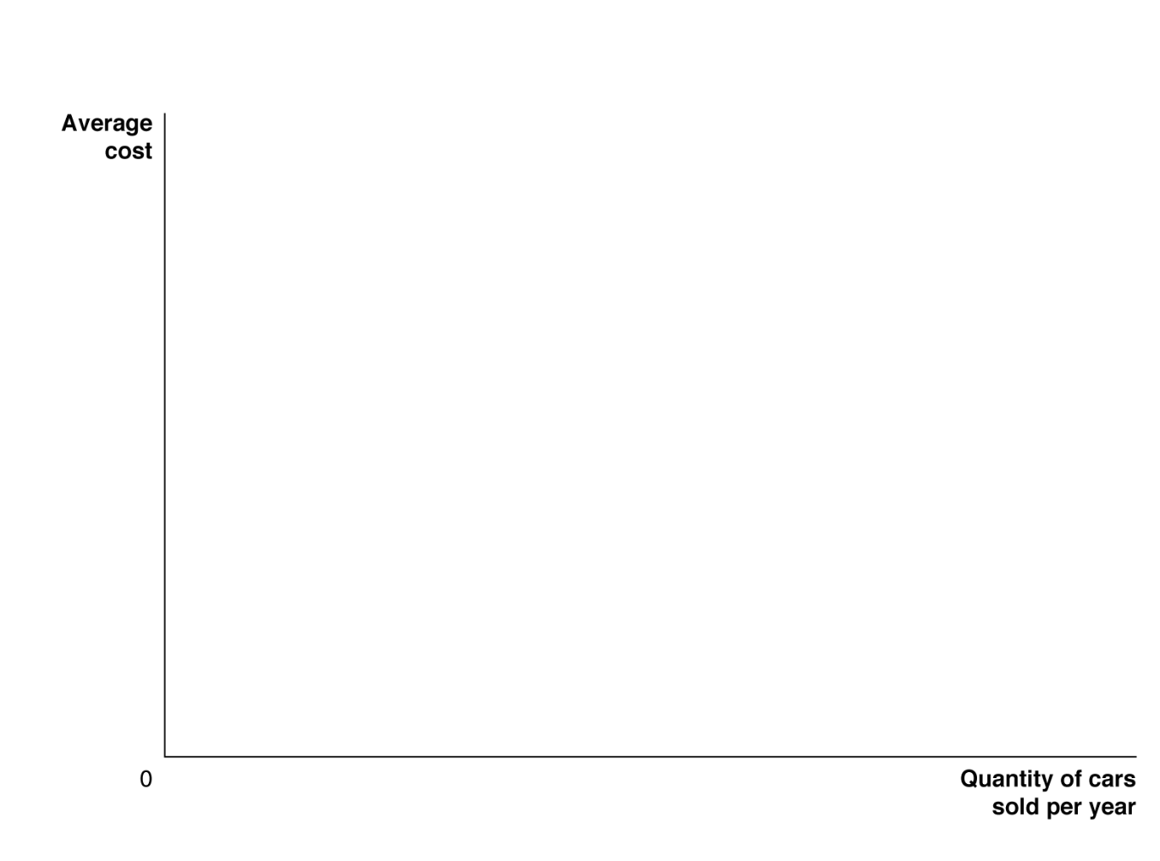



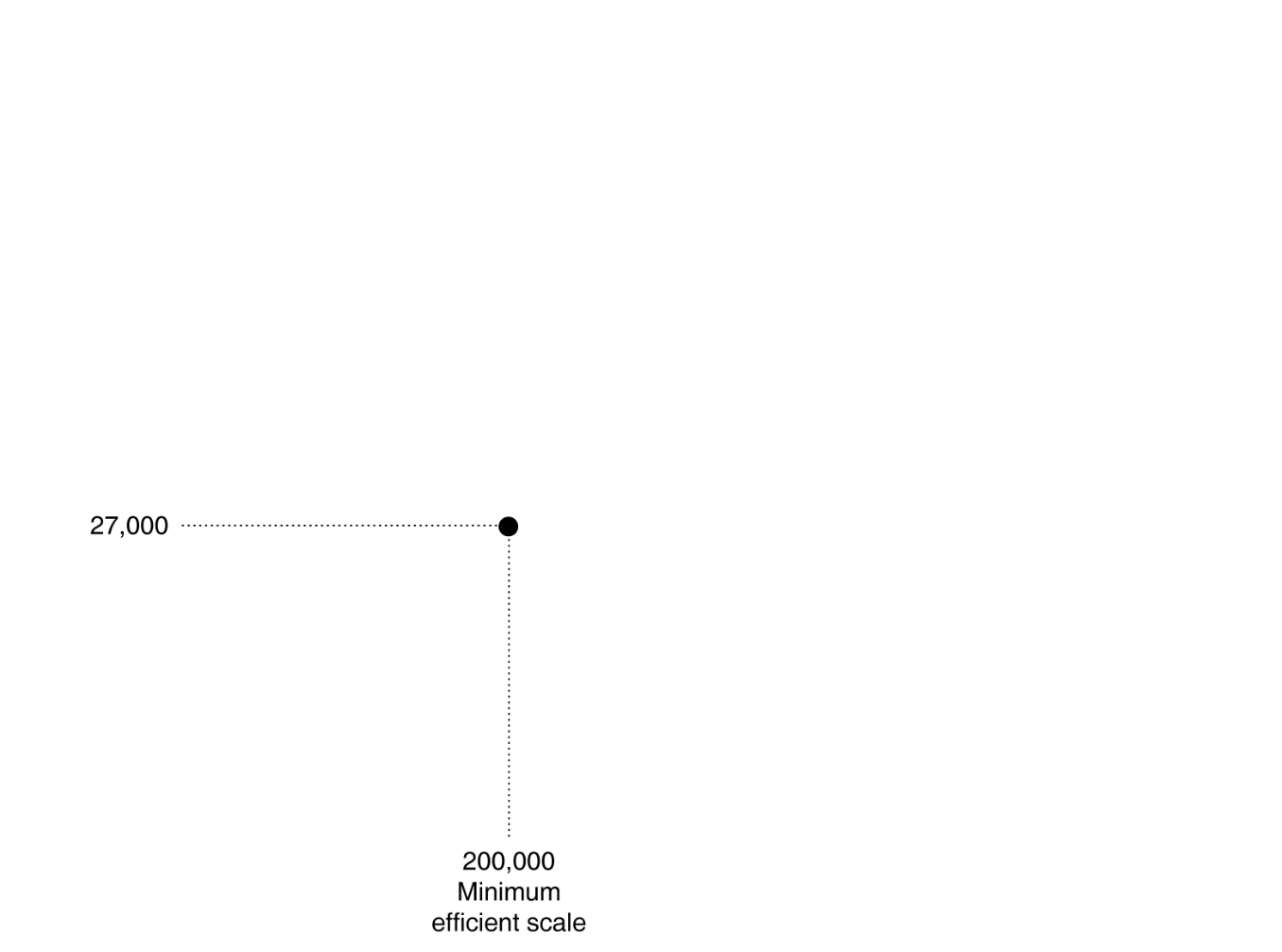


Changes in the Long Run Cost Curves
Here, a small car factory can produce at a lower average cost than a large one, for small quantities. For more output, a larger factory is more efficient.
Notes:
If a small car company expects to sell only
20,000 cars per year, it will be able to produce
cars at the lowest average cost of $52,000 per
car if it builds the small factory represented
by the ATC curve on the left of the figure.
A larger factory will be able to produce 200,000
cars per year at a lower cost of $27,000 per car.
An automobile factory producing 200,000
cars per year and a factory producing 400,000
cars per year will experience constant returns
to scale and have the same average cost. An
automobile factory assembling 200,000 cars
per year will have reached minimum efficient
scale. Very large automobile factories will experience
diseconomies of scale, and their average
costs will rise as production increases
beyond 400,000 cars per year.

Slide 15
Economies of Scale
At low quantities, a firm might experience economies of scale.
Notes:
If a small car company expects to sell only
20,000 cars per year, it will be able to produce
cars at the lowest average cost of $52,000 per
car if it builds the small factory represented
by the ATC curve on the left of the figure.
A larger factory will be able to produce 200,000
cars per year at a lower cost of $27,000 per car.
An automobile factory producing 200,000
cars per year and a factory producing 400,000
cars per year will experience constant returns
to scale and have the same average cost. An
automobile factory assembling 200,000 cars
per year will have reached minimum efficient
scale. Very large automobile factories will experience
diseconomies of scale, and their average
costs will rise as production increases
beyond 400,000 cars per year.

Slide 16
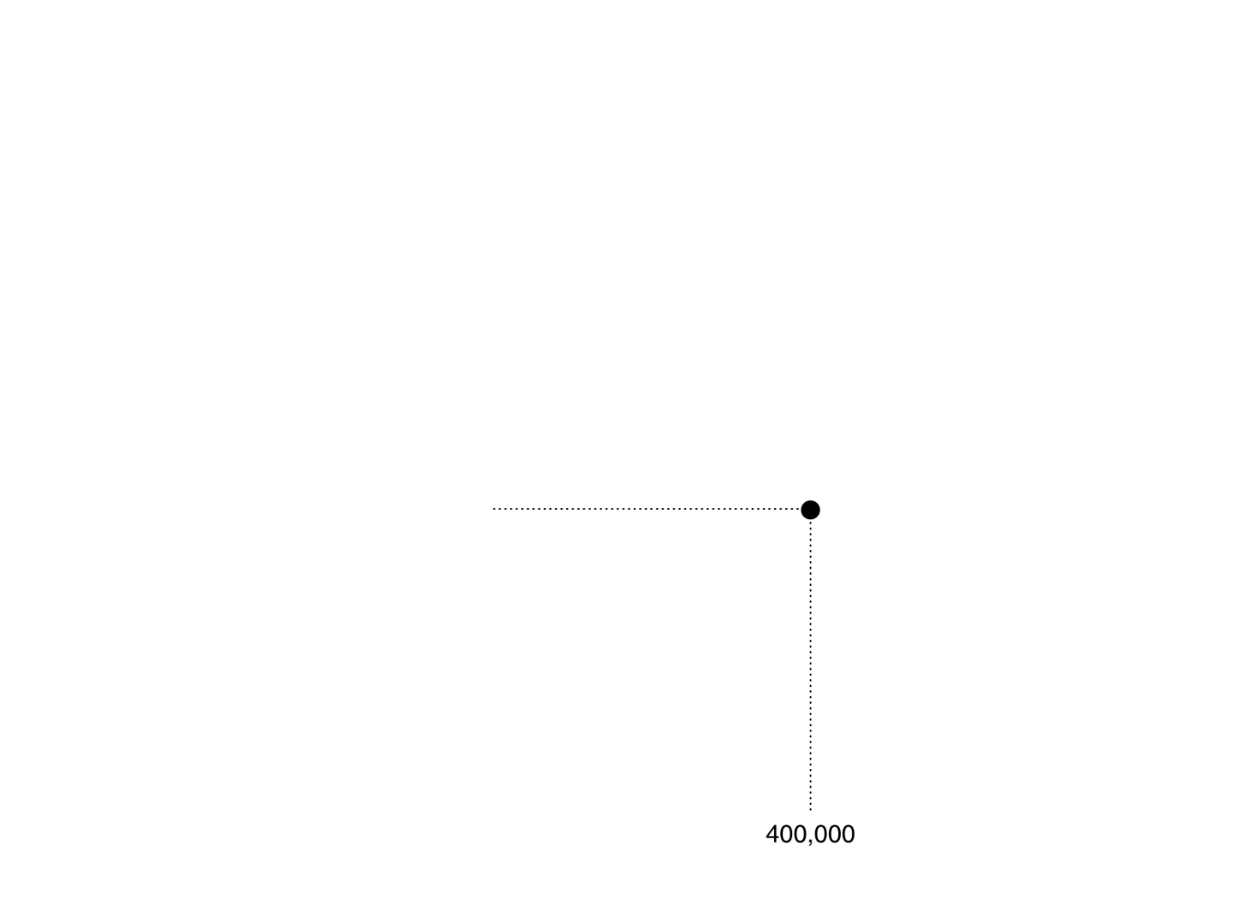

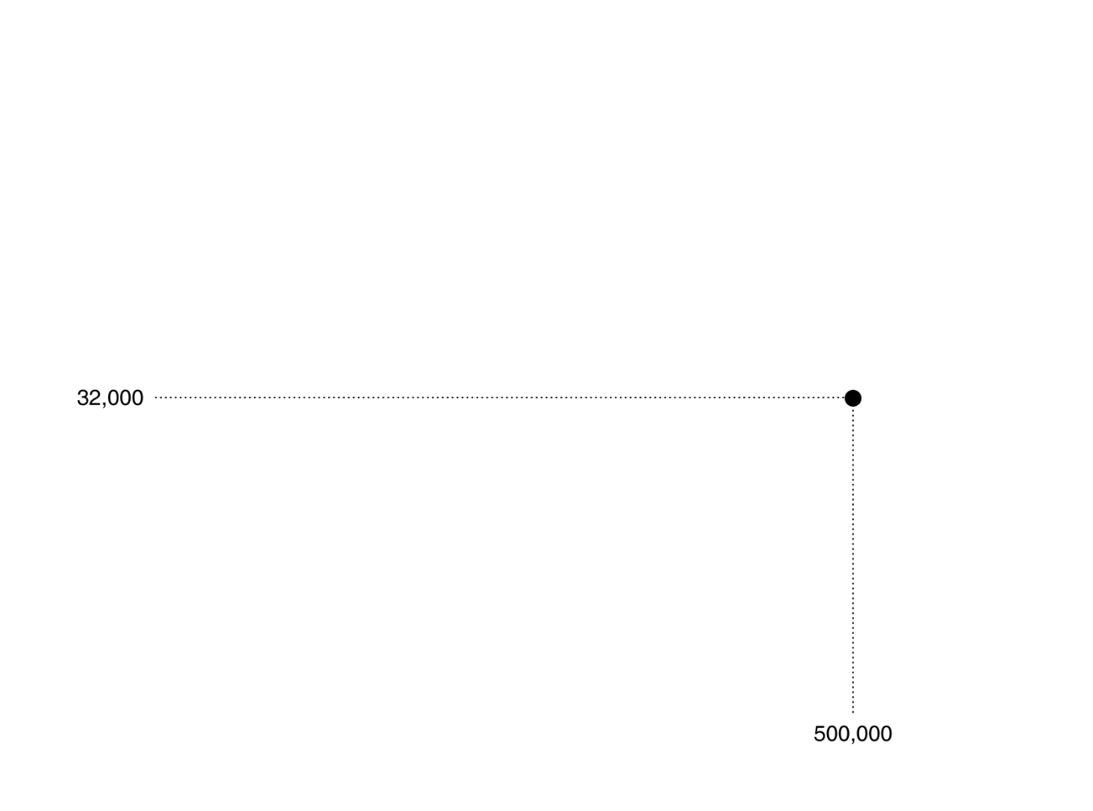

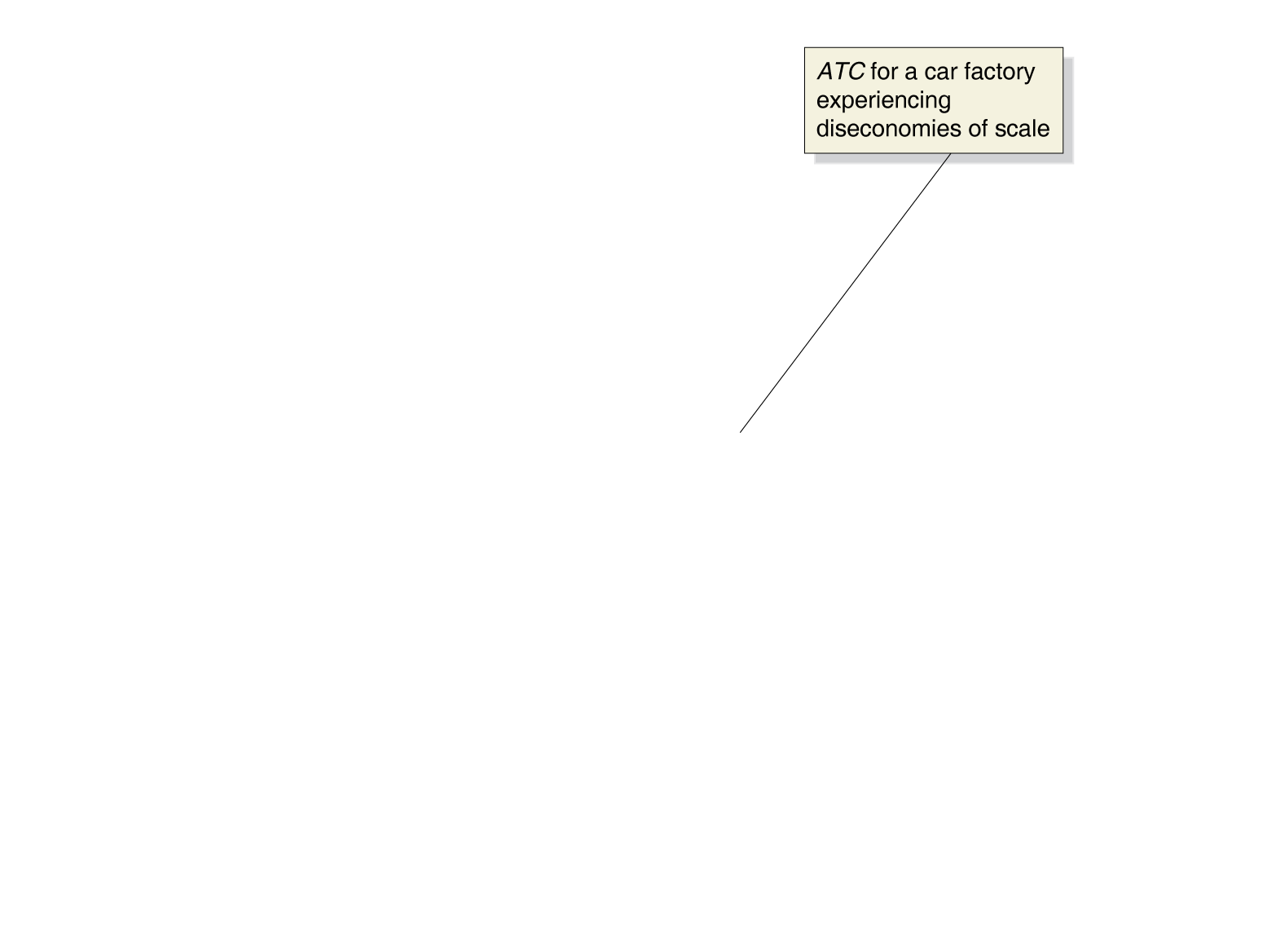
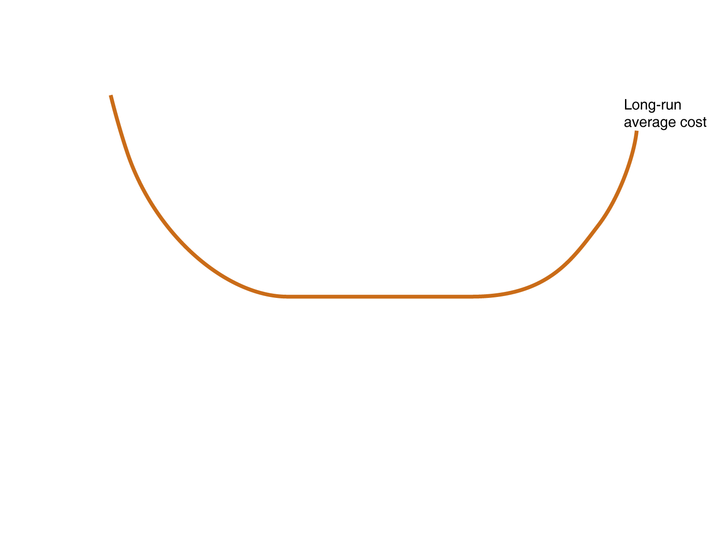
Constant Returns to Scale
The lowest level of output at which all economies of scale are exhausted is known as the minimum efficient scale.
At some point, the firm experiences constant returns to scale.

Slide 17
Diseconomies of Scale
Eventually, firms might get so large that they experience diseconomies of scale.

Slide 18
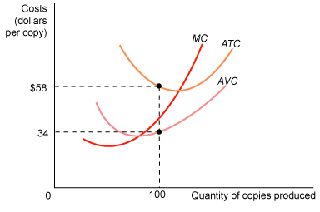
Refer to the graph below. How much is the value of total fixed cost (Q=100, ATC=$58 and AVC=$34)?
2,400
3,400
5,800
None of the above. Total fixed cost cannot be computed using this graph.

Slide 19
Refer to the graph below. How much is the value of total fixed cost?
2,400

Slide 20
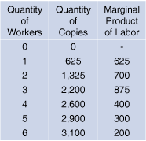
Refer to the table below. What is the marginal cost of producing the first 625 copies when the wage is $50?
Zero.
$75.00.
$0.08
$625.

Slide 21
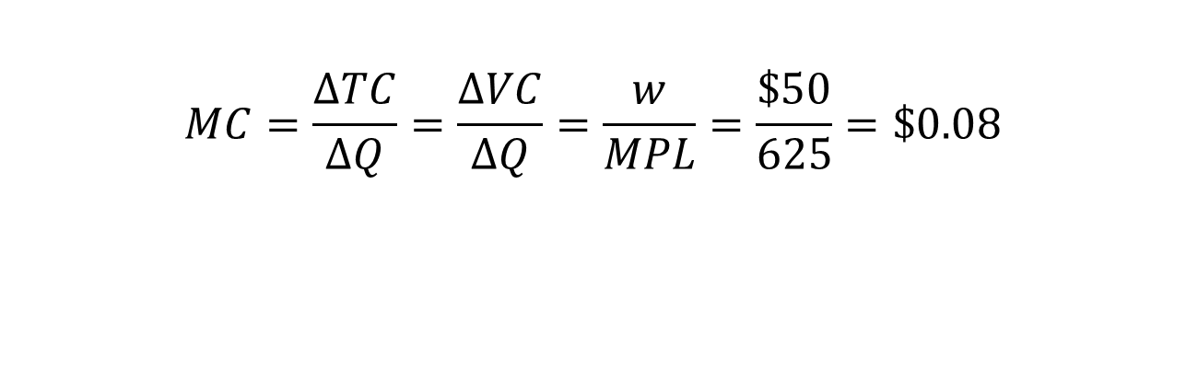
Refer to the table below. What is the marginal cost of producing the first 625 copies when the wage is $50?
$$MC=\frac{∆TC}{∆Q}=\frac{∆VC}{∆Q}=\frac{w}{MPL}=\frac{\$50}{625}=\$0.08$$

Slide 22
Bruno produces 600 pizzas a week with one pizza oven. On average, each pizza costs $8 to produce. If Bruno buys another pizza oven, he could produce each pizza for $5 on average, but a third pizza oven would raise his average cost. Which of the following statements are TRUE? Select all that apply. A. In the long run, Bruno should buy another pizza oven. B. Bruno is experiencing diseconomies of scale. C. 600 pizzas and $8 is on Bruno's LRATC curve. D. 600 pizzas and $5 is on Bruno's LRATC curve.

Slide 23
Bruno produces 600 pizzas a week with one pizza oven. On average, each pizza costs $8 to produce. If Bruno buys another pizza oven, he could produce each pizza for $5 on average, but a third pizza oven would raise his average cost. Which of the following statements are TRUE? Select all that apply. A. In the long run, Bruno should buy another pizza oven. B. Bruno is experiencing diseconomies of scale. C. 600 pizzas and $8 is on Bruno's LRAC curve. D. 600 pizzas and $5 is on Bruno's LRAC curve.

Slide 24

Average Cost ($/pizza)
SAC(k=1)
SAC(k=2)
SAC(k=2)
SAC(k=3)
$8
$5
600
Pizzas per week

Slide 25
Fill in the table. At approximately what quantity does the MC curve cross the ATC curve?
Quantity | Total Cost | ATC | MC
0 | 1000 | *** | ***
20 | 1200 | 60 | 10
45 | 1400 | 31.1
75 | 1600 |  | 6.7
100 | 1800 | 18
120 | 2000 | 16.7
135 | 2200 |  | 13.3
145 | 2400 |  | 20
150 | 2600 | 17.3

Slide 26
Fill in the table. At approximately what quantity does the MC curve cross the ATC curve?
Quantity | Total Cost | ATC | MC
0 | 1000 | *** | ***
20 | 1200 | 60 | 10
45 | 1400 | 31.1 | 8
75 | 1600 | 21.3 | 6.7
100 | 1800 | 18 | 8
120 | 2000 | 16.7 | 10
135 | 2200 | 16.3 | 13.3
145 | 2400 | 16.6 | 20
150 | 2600 | 17.3 | 40

